Slide 1
Distributed Computing Abstraction Layer
It makes possible to write a modular software that thinks it works on a single computer but in fact it is not.
Part 1: General definitions.
It is a realization of an idea that the web-service conceptually is not different from, for instance, PFCS.
Having realized that, it is possible to make a process communicate with multiple clients via different protocols.
A single framework should be based on a class-factory that handles serialization.
The component performs the inter-process communication and serialization. It is a base vehicle of Common API.
The component is a shared library.
The component implements a Data Exchange API.
The component exposes a number of C-functions that refer to C++ classes.
For each data type there is one function to send data.
For each data type there is one function to associate a callback object that receives data.
The component implements publish/subscribe connectors.
A connector is an object that implements an asynchronous data exchange between processes.
When user process calls function to send data, it does not block.
The data that is exchanged between processes is serialized.
A connector implements data serialization as well.
IPC method that is used by connector can be a shared memory, domain socket, TCP/IP socket and HTTP web service.
HTTP web service may be used as a bridge between processes on different computers.
IPC method and method of data serialization for each connector are configured in a text file.
There can be one configuration file per process.
The configuration file contains definitions of all connectors that are instantiated by the process.
The configuration file represents serialized configuration objects.
Each connector is associated with a number of specific data types.
The names of data types are listed in configuration file as well.
The configuration file may also contain pre-defined subscribers for a particular connector.
When process sends a specific data, it is in general unaware what connectors are going to be used.
When a receive callback function is called, a name of a connector is passed along with a received data.

Slide 2
Part2: Connectors.
The connector is used to pass data between unrelated processes.
The connector has a unique computer-wide name.
The connector consists in general of 2 (two) half-duplex data transfer channels.
First head of a channel is a listener that listens to and handles incoming data packets.
Second head of a channel is used to send data to a listening process that has subscribed to specific data.
First head of a channel acts as a server.
Second head of a channel acts as a client.
First head of a channel has to be created by a listening process before any client can connect to it.
The name of a first head of a channel is built of a name of listening process and name of connector.
Second head of a channel connects to the first head of a channel.
Second head of a channel can be created either dynamically or statically one per subscriber.
The subscriber’s name consists of IP address of computer, and name of a process.
Dynamic second head is created upon a send-request.
Dynamic second head may be closed either immediately, or after a specified inactivity time-out.
Static second head is only possible when shared memory is used as a transfer media.
Both channels are optional.
Each process owns zero or one first head of a first channel.
Each process owns zero or many second heads of a second channel.
A subscribe-request is a special purpose data packet.
When data is sent through a channel it is appended with a binary header.
The purpose of a binary header is to enable data-fragmentation when the size of a channel is smaller than data.
The binary header describes a number of fragments, the current number of a fragment and the size of a fragment.

Slide 3
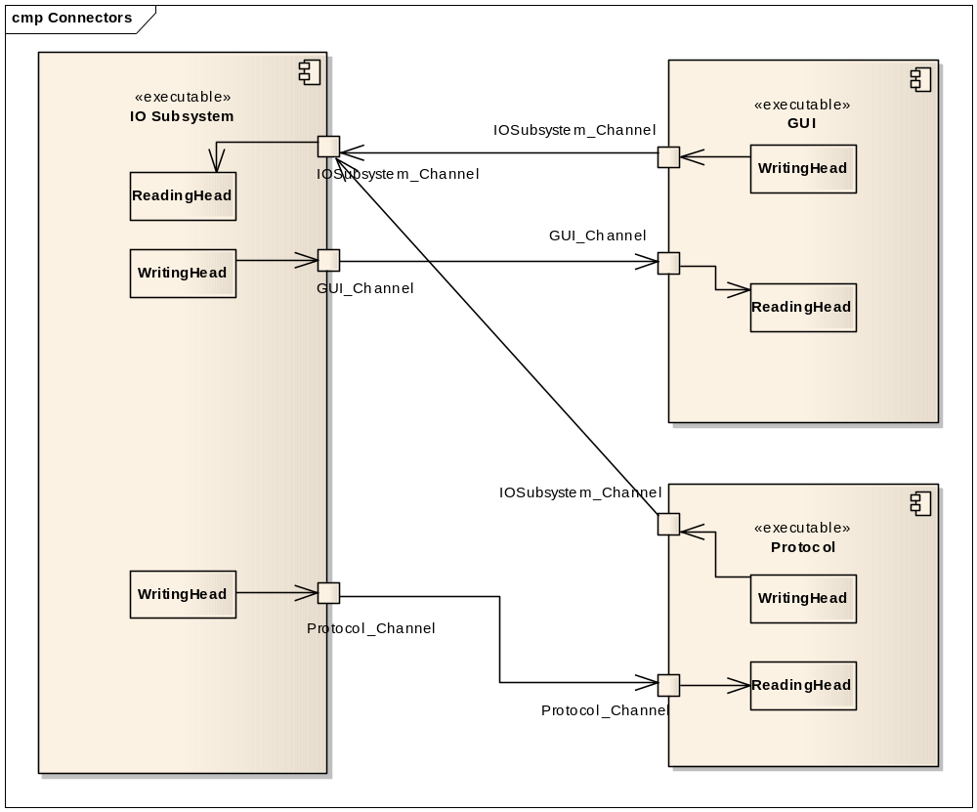

Slide 4
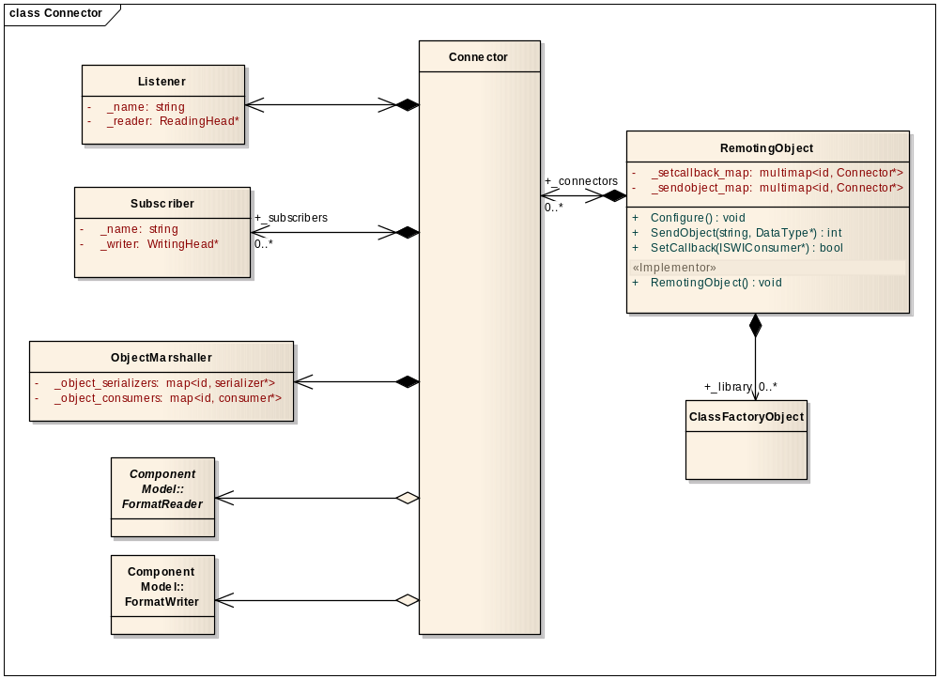

Slide 5
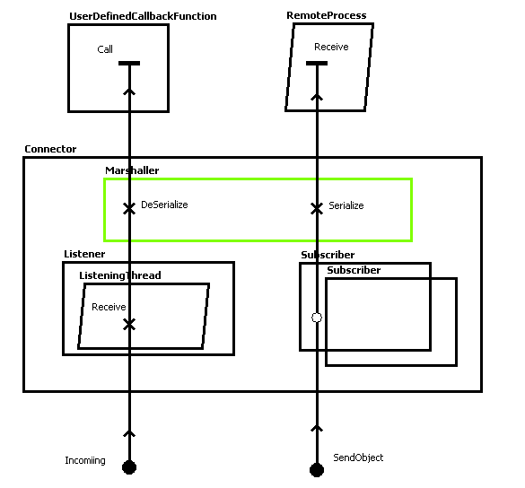
UCM Diagram of the Connector object.
The two paths designate the two major functions of the connector.

Slide 6
Part 3: Serialization.
The serialization layer is better described as a collection of class factory objects one per data type.
The serialization can be done in ASCII, or binary format.
Each channel can use either ASCII or binary formatting, not both.
Binary format is not to be used for a network communication.
Binary format consists of a header and an exact copy of a structure that is to be sent.
The purpose of a binary format’s header is to indicate the name of a data type.
ASCII format can be either XML, or WSI.
When XML is used, then it is used without XML schema definition document.
Each data type is assigned a unique name.
The name of a data type is used to find a correct class factory object in a collection of objects.
Class factory object is built using C++ compiler technology, not a meta-data.
Class factory object contains an instance of associated data type.
Each member of a data type is bound to a specialized “get” and “set” function of class factory object.
All class factory objects are declared in a separate C++ file and resolved during compile time.
Client and server processes share same library of precompiled class factory objects.
Server process should not break if mismatch in version should happen.

Slide 7
Part 4: Implementation
IPC implementation consists of four DLL: IPCGate, IPCClassFactory, IPCObject, IPCInterface.
The sources of DLLs are located in SourcesIPC/IPC folder.
IPCGate contains OS-dependent implementations of operations on file, semaphore, critical section, pipe, thread.
IPCClassFactory contains class templates that build up Serialization objects, Callback functions, Marshaller, WSIParser.
IPCObject contains implementation of RemotingObject. RemotingObject consists of Connectors. It is a Serializable object that allows for definition of its configuration in a text string.
IPCInterface implements an interface to a single instance of RemotingObject.It also implements the thread-pool.
User code reaches the IPC functionality via include files.
The include files are located in SourcesIPC/Include folder.
There are two major include files: IPCInterface.h and RPCTemplates.h.
IPCInterface.h declares functions of IPCGate, ClassFactory framework, and interface to RemotingObject.
RPCTemplates.h defines five major template functions which encapsulate the entire IPC functionality.

Slide 8
Five Major template functions.
template<class T> api_handle SetCallback(void (*f)(T*))
template<class T> int PostObject(T *obj)
template<class T> int SendObject(T *obj)
template<class Q, typename R> api_handle SetRpcCallee(R (*f)(Q*))
template<typename Q, typename R> int QueryObject(Q& query, R& rval)
SetCallback instantiates a wrapper class CWSICallback<Argument> that contains a pointer to a function that has to be called when a new Argument object is received by RemotingObject.
CWSICallback is registered with RemotingObject framework as a callback function that handles an arrival of Argument object
SetRpcCallee is similar to SetCallback. It instantiates a wrapper class CWSIRpcCall<Argument> that contains a pointer to a function that has to be called remotely.
CWSIRpcCall is registered with RemotingObject framework as a callback function that handles an arrival of Argument object. Therefore the remote function is distinguished by its Argument type.

Slide 9
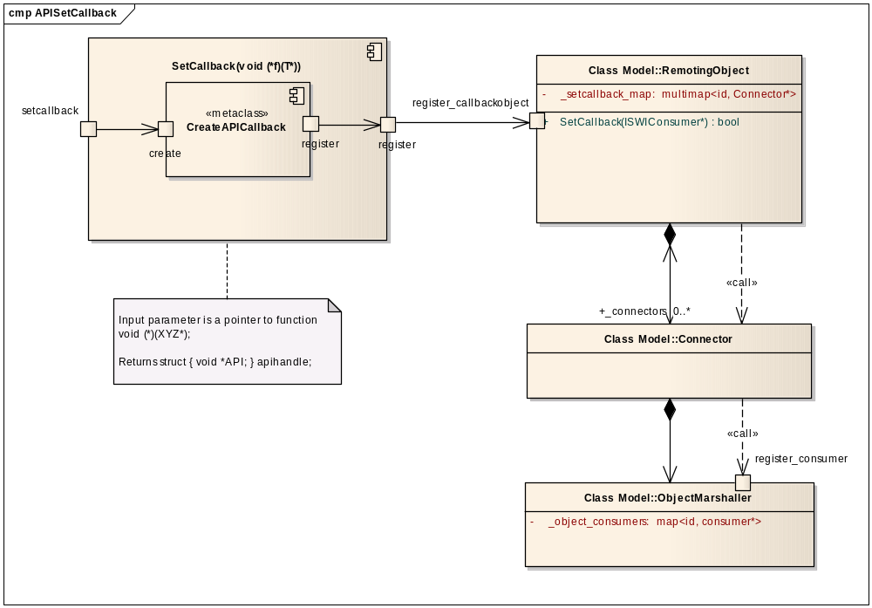
UML Diagram describing details of SetCallback function call.

Slide 10
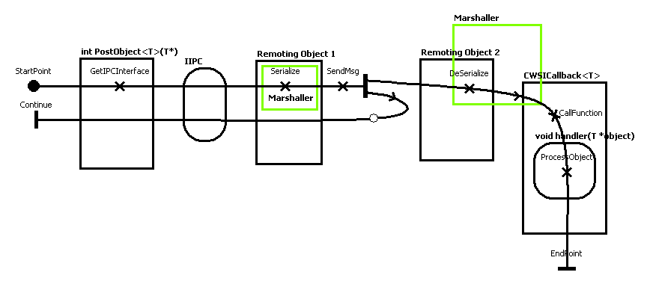
UCM Diagram describing behavioral fabric of PostObject function call.
IIPC in the diagram stands for IPCObjInterface structure found in IPCInterface.h.
Remoting Object 2 should have an instance of CWSICallback class that is linked to the user callback function. This is achieved by calling SetCallback prior to the call of PostObject.
Remoting Object 1 should have an instance of Subscriber class pointing to Remoting Object 2. The Subscriber class should have a necessary data type declared.

Slide 11
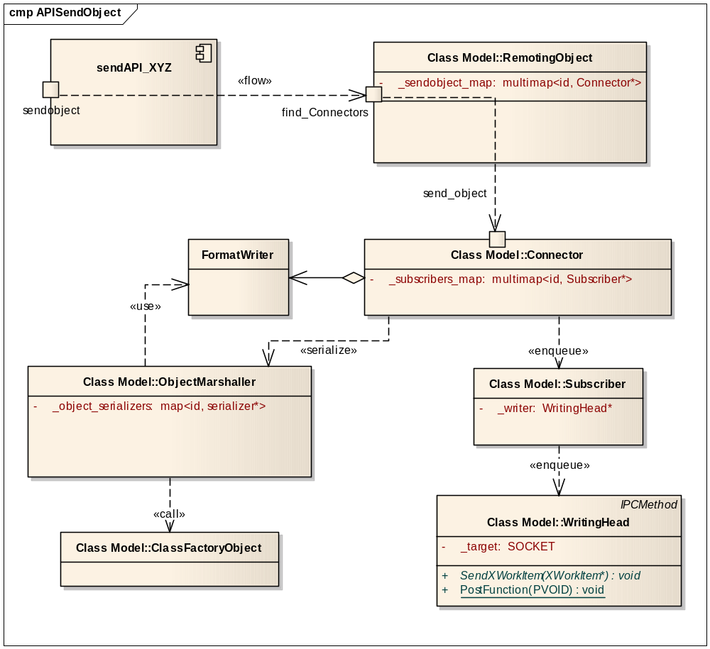
UML Diagram describing details of Remoting Object 1 sending an object.

Slide 12
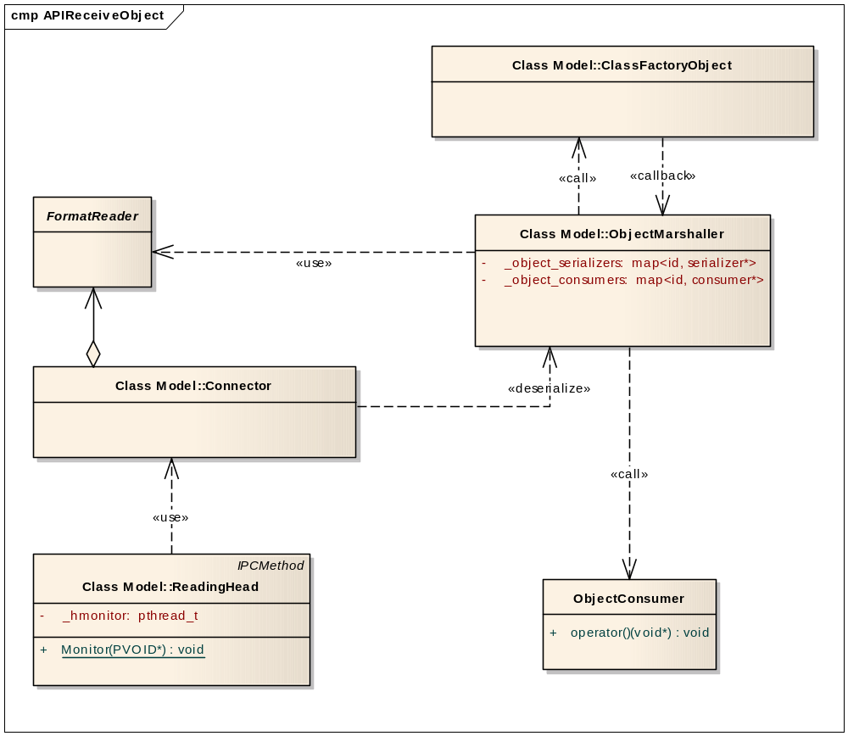
UML Diagram describing details of Remoting Object 2 receiving an object.

Slide 13
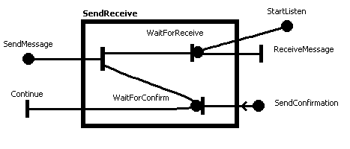
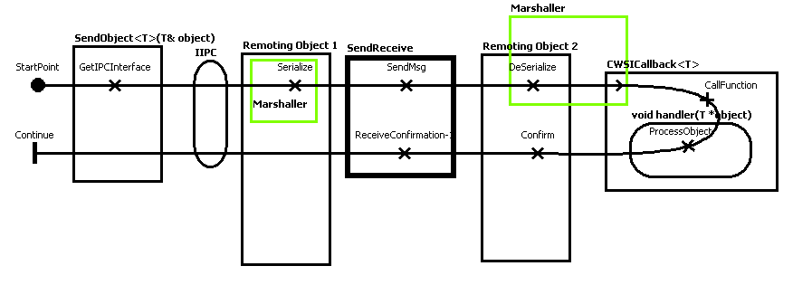
UCM Diagram describing behavioral fabric of SendObject function call.
Send-Object functionality is similar to Post-Object functionality except that Send-Object waits for a confirmation.

Slide 14
Remote Procedure Call.
RPC is built on top of SendObject and SetCallback.
RPCTemplates.h contains two major template functions that help establish remote procedure call:
api_handle SetRpcCallee(R (*f)(Q*));
int QueryObject(Q& query, R& rval);
SetRpcCallee instantiates a wrapper class CWSIRpcCall that contains a pointer to function that has to be called. CWSIRpcCall is registered with RemotingObject framework as a callback function that handles an arrival of Argument object. Therefore the remote function is distinguished by its Argument type. The pointer to the wrapper class is stored in type-less structure api_handle.
When a new Argument object is received, CWSIRpcCall calls contained function.
When contained function returns, CWSIRpcCall calls ReturnObject method of the RemotingObject framework.
QueryObject instantiates a wrapper class CWSIRpcCallback that contains an object representing the return value of the remote function. CWSIRpcCallback is registered with RemotingObject framework as a callback function that handles an arrival of the Return value. After that the QueryObject calls SendObject to send Agrument object.
SetRpcCallee must be called in the remote process before any remote calls can be made.
QueryObject is called in the local process.
The RemotingObject of the remote process should have a Connector that handles objects of the function’s Argument type.
The RemotingObject of the local process should have a Connector that handles objects of the function’s Return-Value type.

Slide 15
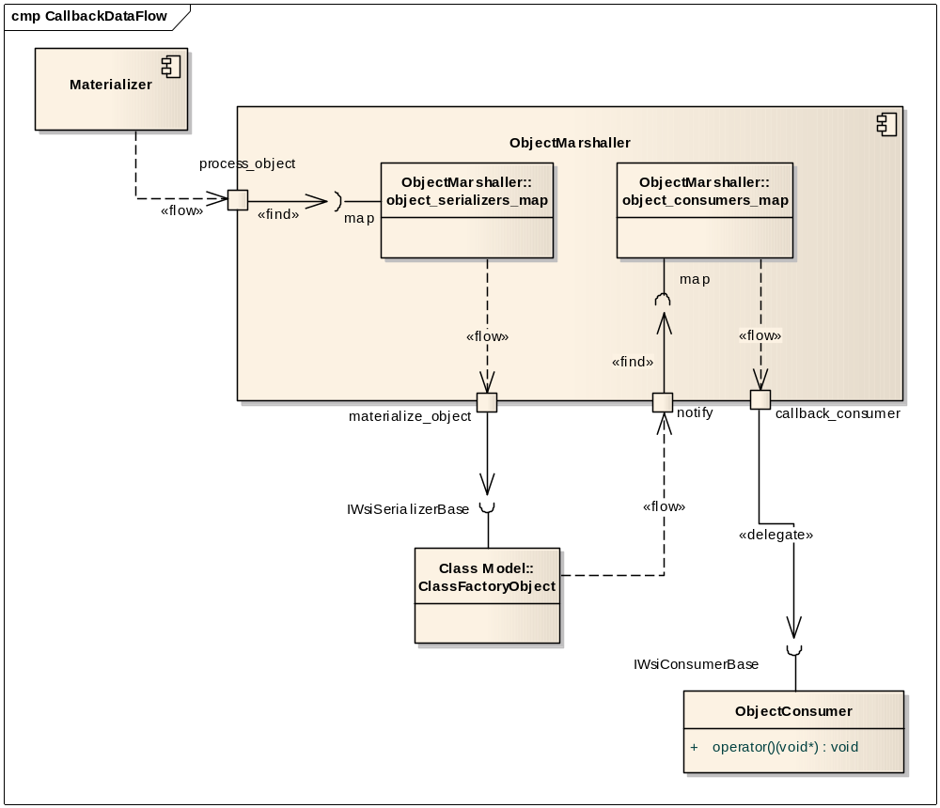
UML Diagram describing instantiation of an Object by the marshaller.

Slide 16
Using WSIClassFactory
WSIClassFactory serializes/de-serializes classes and structures.
A Serializable class member can be a fundamental type, an instance of other class, an array or vector of a fundamental type or class.
A class member of a fundamental type is called a flat member.
WSIClassFactory can not serialize/de-serialize pointers and references except a pointer to character.
A pointer to character is treated as a zero terminated string.
Not all class members must be declared for serialization. Only those members of a class that user is interested in transferring must be declared for serialization.
WSIClassFactory.h file contains five major macros that establish a method of declaration for serialization.
BEGIN_WSI_SERIALIZATION_OBJECT(ClassName)
CONTAINS_FLAT_MEMBER(Member, Identifyer)
CONTAINS_OBJECT_MEMBER(Member, Identifyer)
END_WSI_SERIALIZATION_OBJECT()
AUTOCREATE_WSI_SERIALIZATION_OBJECT(ClassName)
The macros must be used in the above listed order.
AUTOCREATE_WSI_SERIALIZATION_OBJECT defines a global instance of CWsiRootSerializer<ClassName> in the current namespace of an .h file. The namespace is declared through definition of WSI_NAMESPACE at the beginning of .h file. It is recommended to use a separate namespace for each .h file.
An instance of CWsiRootSerializer<ClassName> adds itself to a static CWsiRootCollection class that contains a collection of CWsiRootSerializers in the given namespace.
CWsiRootCollection is used for initial population of a dynamically created CWsiCollection class.
In order to use a collection of Class-Serializers with the RemotingObject, it is necessary to merge this collection with the collection stored in the RemotingObject. It is done via ADD_WSINAMESPACE(Namespace) macro. Thus the data-type-names declared in a Subscriber and/or Listener are resolved, i.e. each declared data-type is represented then by a corresponding serialization object.

